Slide 1
MITRE ATT&CK® for Industrial Control Systems
GIAN MARCO DE COLA

Slide 2
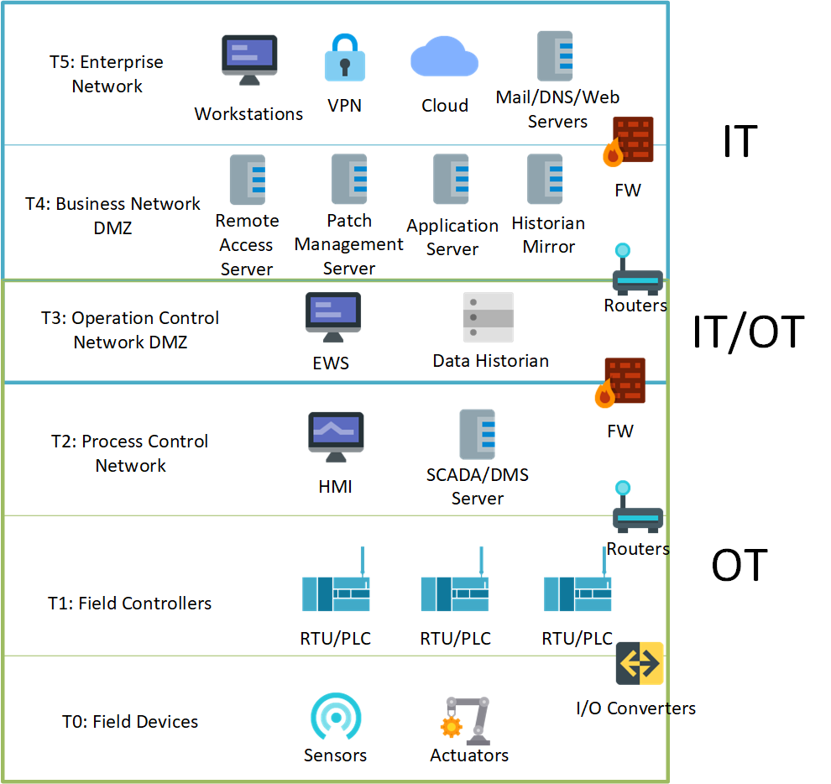
KNOW WHAT - ICS
WHAT IS AN INDUSTRIAL CONTROL SYSTEM?
General term that includes several types of control systems in an industrial setting
Discrete Controllers: most basic form. Controller with integrated operator interface
DCS: controllers and field devices are distributed throughout the system
SCADA: receives operational state from field devices and presents them to operators. Takes command and forwards to the controllers
Purdue Model: reference architecture composed by 6 functional tiers. Tier 2-0 are OT based.

Slide 3
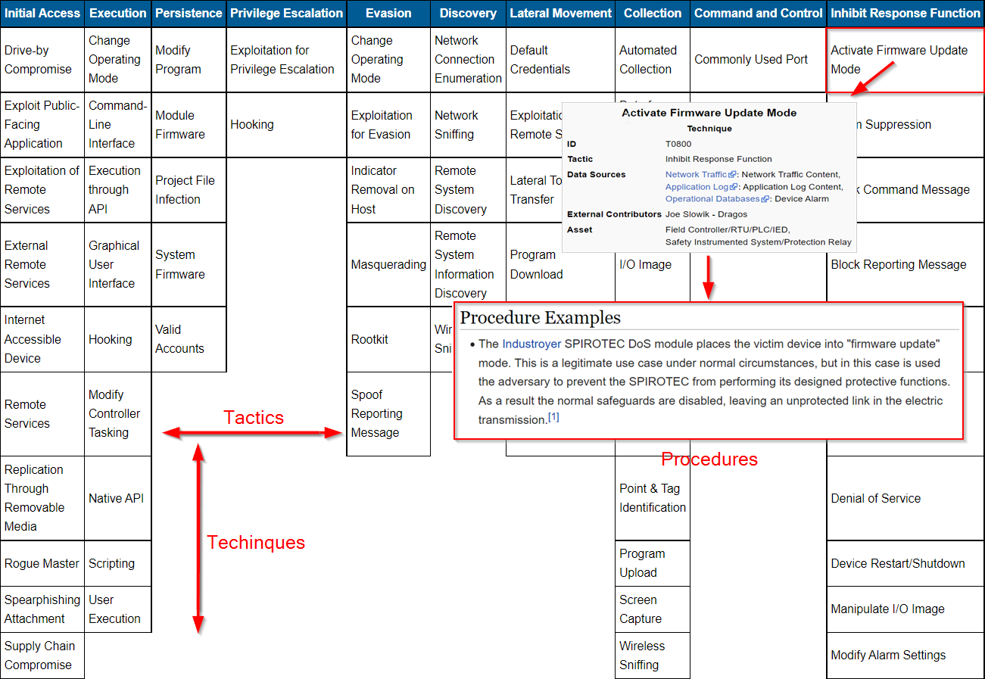
KNOW WHAT – MITRE ATT&CK
WHAT IS THE ATT&CK FRAMEWORK?
A knowledge base for cyber adversary behavior
Based on real-world observations, OSINT fed
Free, open and globally accessible
Community driven and continuously growing
Focus on TTPs instead of IoCs
Different matrices for different cyber domains
*
*: https://collaborate.mitre.org/attackics/index.php/Main_Page

Slide 4
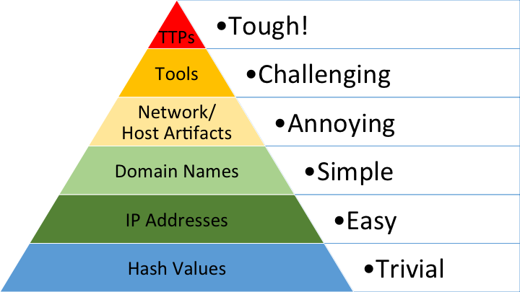
KNOW WHY – MITRE ATT&CK
WHY SHOULD I USE MITRE ATT&CK?
Adversaries tend to change behavior less often
Predictive-Proactive approach instead of a reactive one
Threat-based cybersecurity encompassing cyber threat intelligence
Use cases:
*
*
Adversary emulation, red teaming
SOC maturity assessments
Defensive gap assessments
Failure scenario development
*: http://detect-respond.blogspot.com/2013/03/the-pyramid-of-pain.html

Slide 5
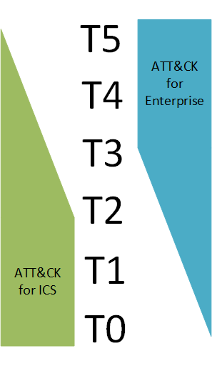
KNOW WHY – ATT&CK for ICS
WHY A NEW MATRIX AND APPROACH ARE NEEDED
The existing ICS environments were not developed with security in mind
With the rise of IIoT, 5G, edge computation… the “air gap” has been filled
Applying enterprise IT approaches and methods to the ICS world can be difficult:
Adversary goals are different (impair process control, physical damage, targeting safety ) - new tactics for ATT&CK
Technology differences (specialized applications and protocols ) - new techniques for ATT&CK
Applying defenses poses new challenges

Slide 6
KNOW HOW – APPLYNG ATT&CK for ICS
TWO CASE STUDIES
1. Defensive Gap Assessment simulation
2. Mapping the 2015 Ukraine power grid incident
Determine which parts of the organization lack defenses
Proactively find vulnerabilities and defensive inattentions
Help prioritize mitigations
Map a famous attack by an APT to better understand their behavior
Useful for future adversary emulation/red teaming (Predictive)
“Assume breach” mentality: guideline on how to reactively detect breaches leveraging APT behavior

Slide 7
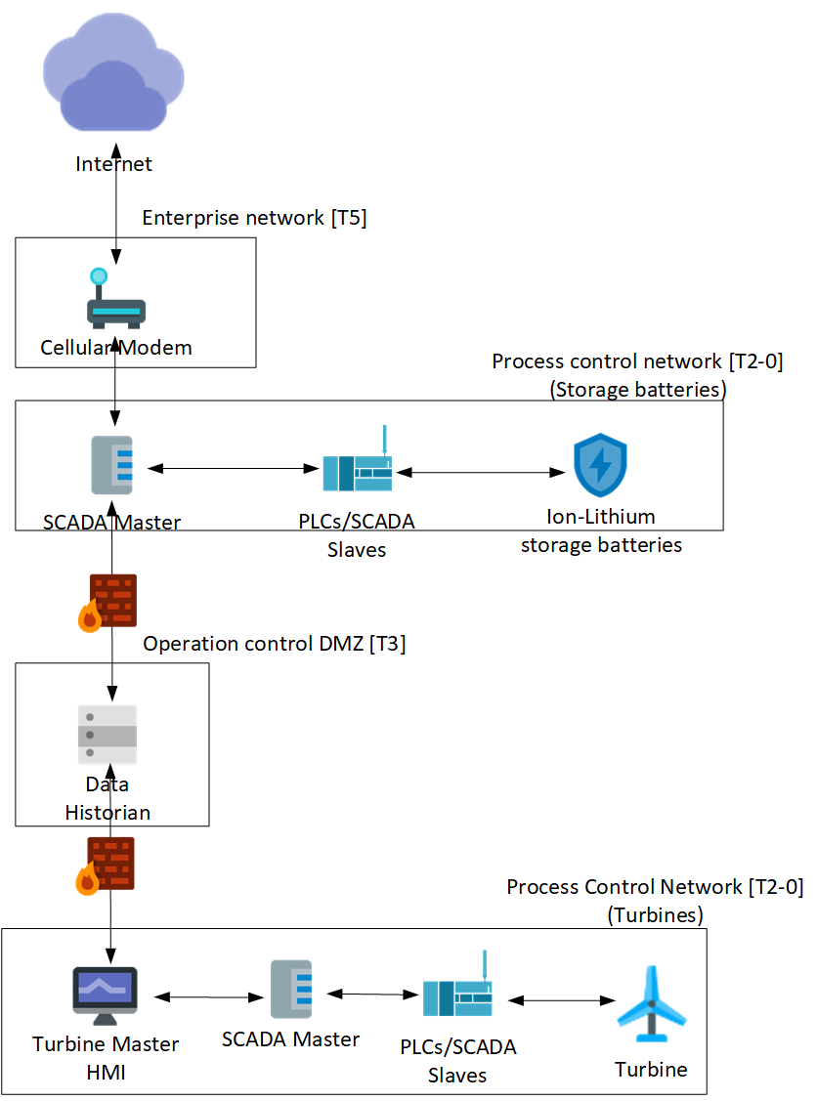
USE CASE 1 - ENVIRONMENT
Energy center consisting of 2 ICS networks:
Wind Turbine network
Storage battery network
White team assesses the center defensive posture:
Strong password policy
Manual intervention for to change operative modes of PLCs
SIM/AV
Packet filtering firewall

Slide 8
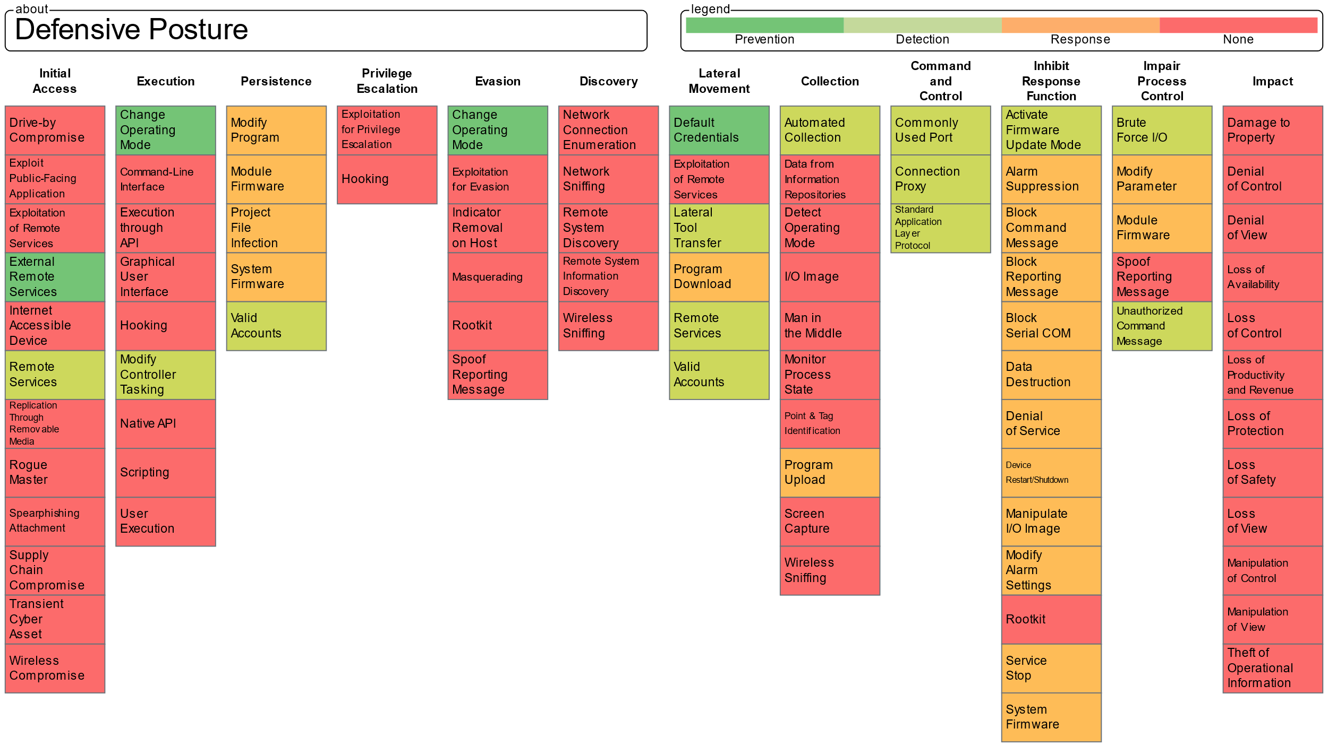
USE CASE 1 - PLAN

Slide 9
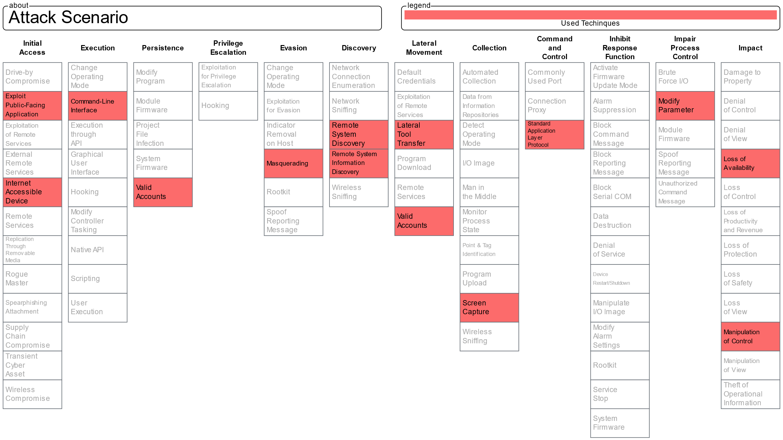
USE CASE 1 – PLAN+DO
Notes:
They then perform this attack on the system or emulate it in a lab environment (adversary emulation case)

Slide 10
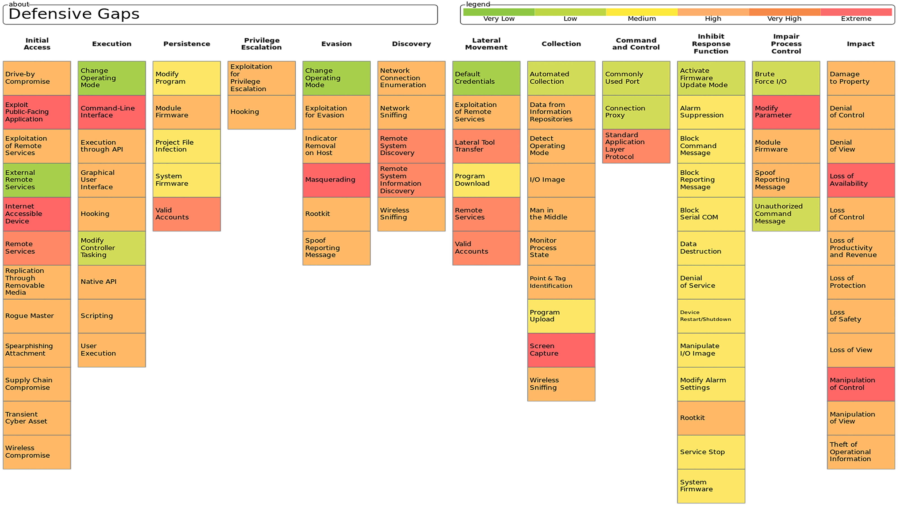
USE CASE 1 - CHECK

Slide 11
USE CASE 1 - ACT
White team integrates gathered data about gap assessment with the overall security posture
A list of prioritized proposed mitigations is compiled
POLICIES
TECHNOLOGIES
Credentials revocation after breach
Modem CLI should be hardened against misuses
Implement correct segregation
Integrate AV with HIDS/NIDS
SIEM for active detection
Integrate existing firewall with application-level gateway

Slide 12
USE CASE 2 – ENTERPRISE SIDE

Slide 13
USE CASE 2 – ICS SIDE

Slide 14
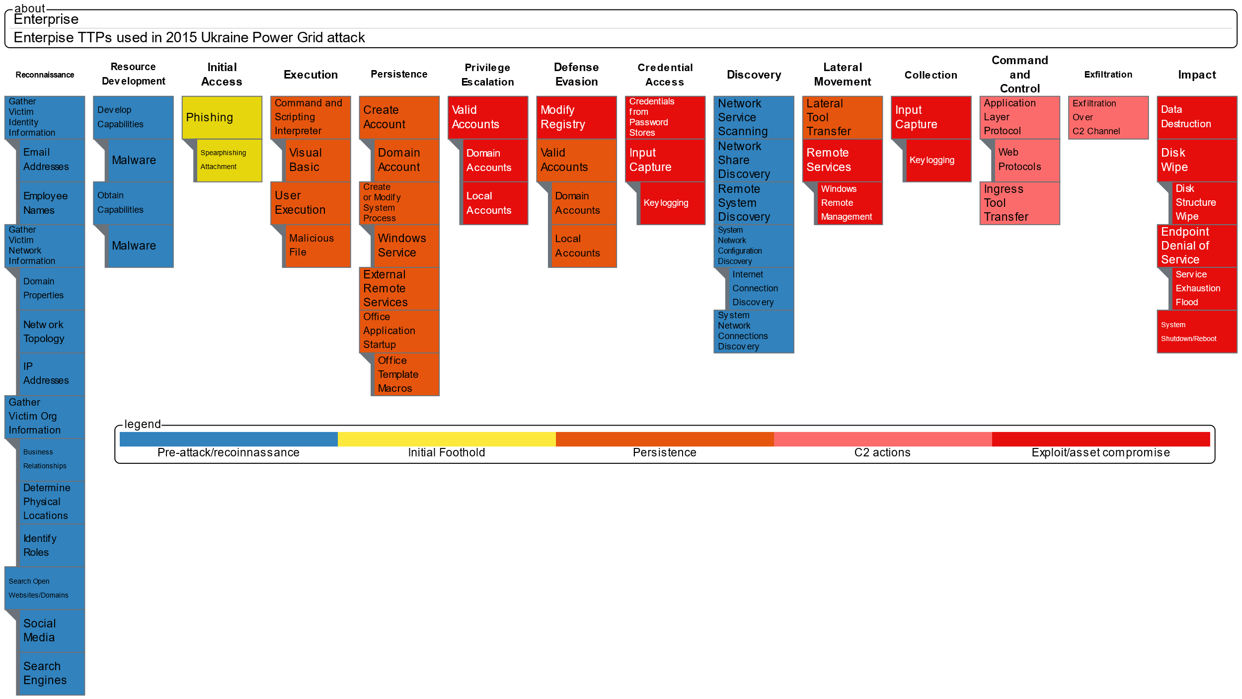
USE CASE 2 – ENTERPRISE MAPPING

Slide 15
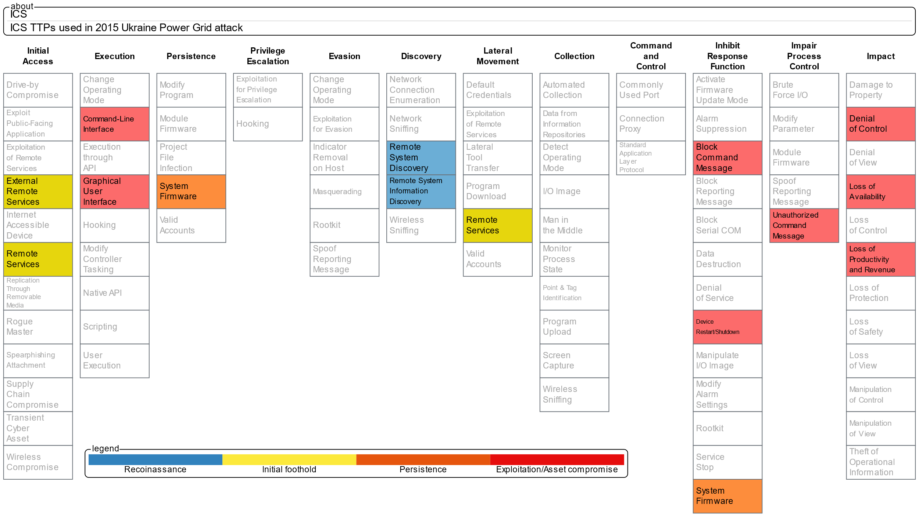
USE CASE 2 – ICS MAPPING

